Slide 1
Sustain software agility, in the face of growth, with Microservices architecture & Cloud
Sep 2024
Alexandru Lungu, Full-Stack developer

Slide 2
E.On Development Guild
Sustain software agility, in the face of growth, with Microservices architecture & Cloud
Introduction
Beyond the Monolith: Microservices
Demo 😀

Slide 3

E.On Development Guild
What does not belong in this picture ?

Slide 4

E.On Development Guild
What does not belong in this picture ?

Slide 5
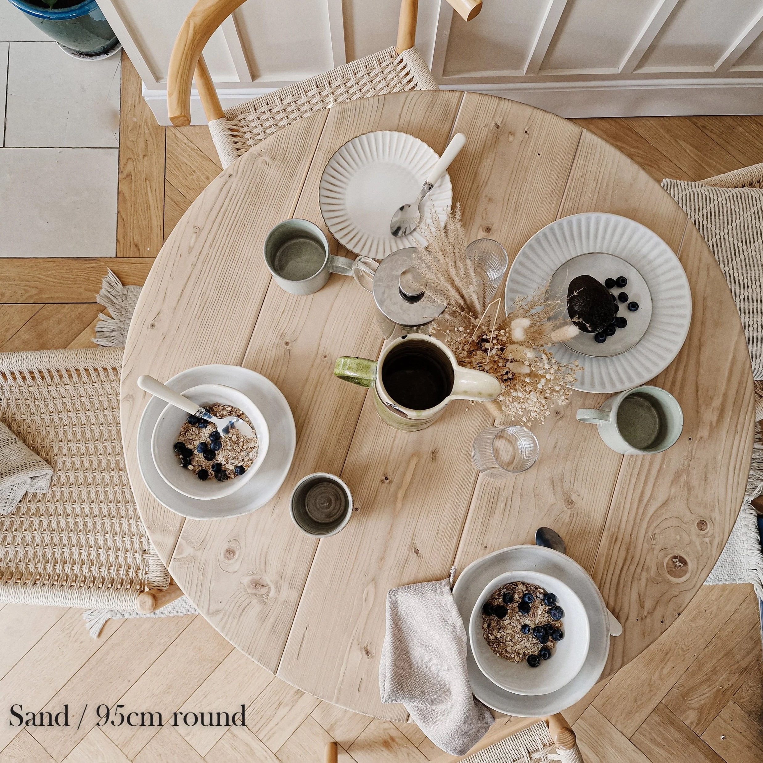


E.On Development Guild
Cohesion: Things that belong toghether should stay in same place

Slide 6
E.On Development Guild
In big/complex software projects, we need to handle 2 forces: cohesion and coupling. This forces apply to features, modules, classes, functionality, services, microservices .
Cohesion: Things that belong toghether should stay in same place
Coupling: If A and B are coupled, they depend on each other. If a change is applied to A, the same change will be applied to B, beacause they are coupled
For clean architecture, we need high cohesion and loose coupling.

Slide 7
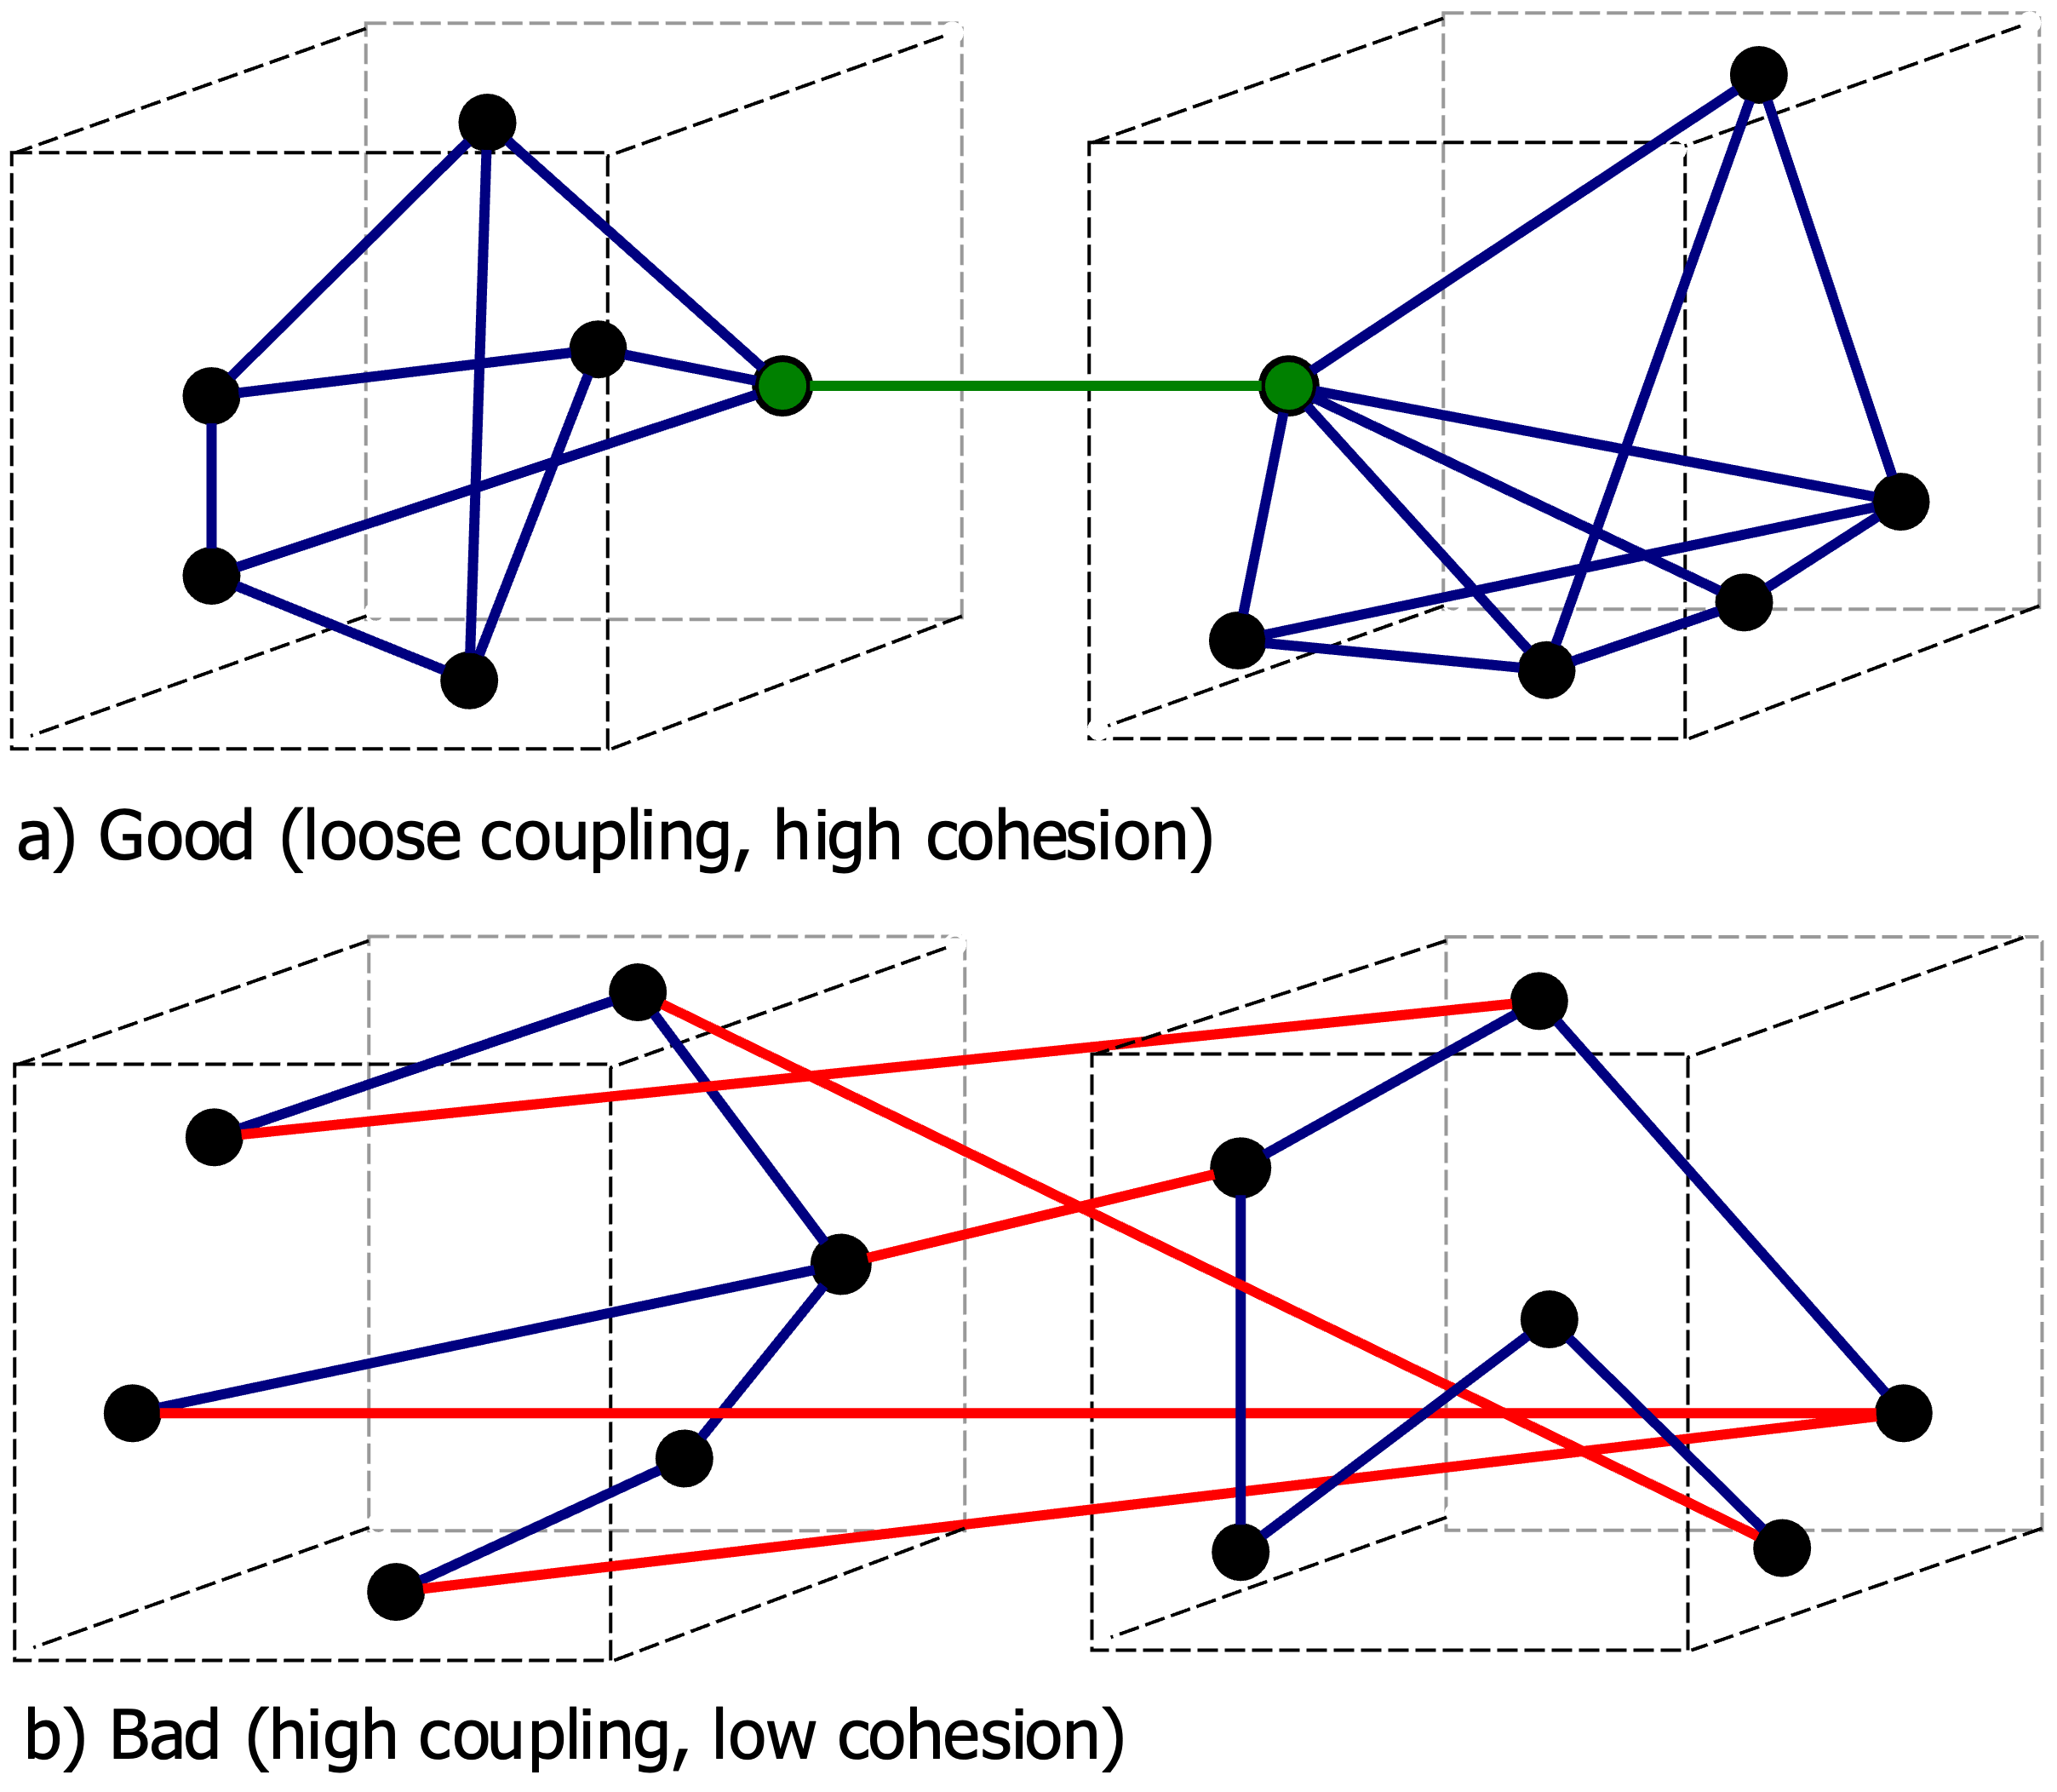
E.On Development Guild
For clean architecture, we need high cohesion and loose coupling.

Slide 8
E.On Development Guild
Dinner table Bounded context
Shoes cabinet Bounded context
High Cohesion
High Cohesion
Loose coupling

Slide 9
E.On Development Guild
What does not belong in this picture ?

Slide 10
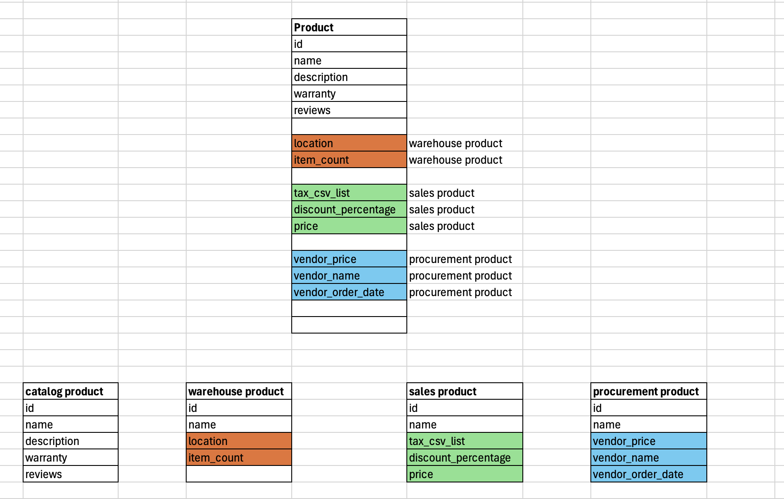
E.On Development Guild
Problem: Single data model – the root of all evil
Monolith
(Unified data
model)
Single data model + big enterprise project:
Hard to make new changes
Hard to maintain
Big ball of mud
People leave projects (sad developers) ☹
Changes take a lot of time, because everything is tightly coupled
Microservices
Modulith
(Multiple data
models)
Bounded context
Bounded context
Bounded context
Bounded context

Slide 11
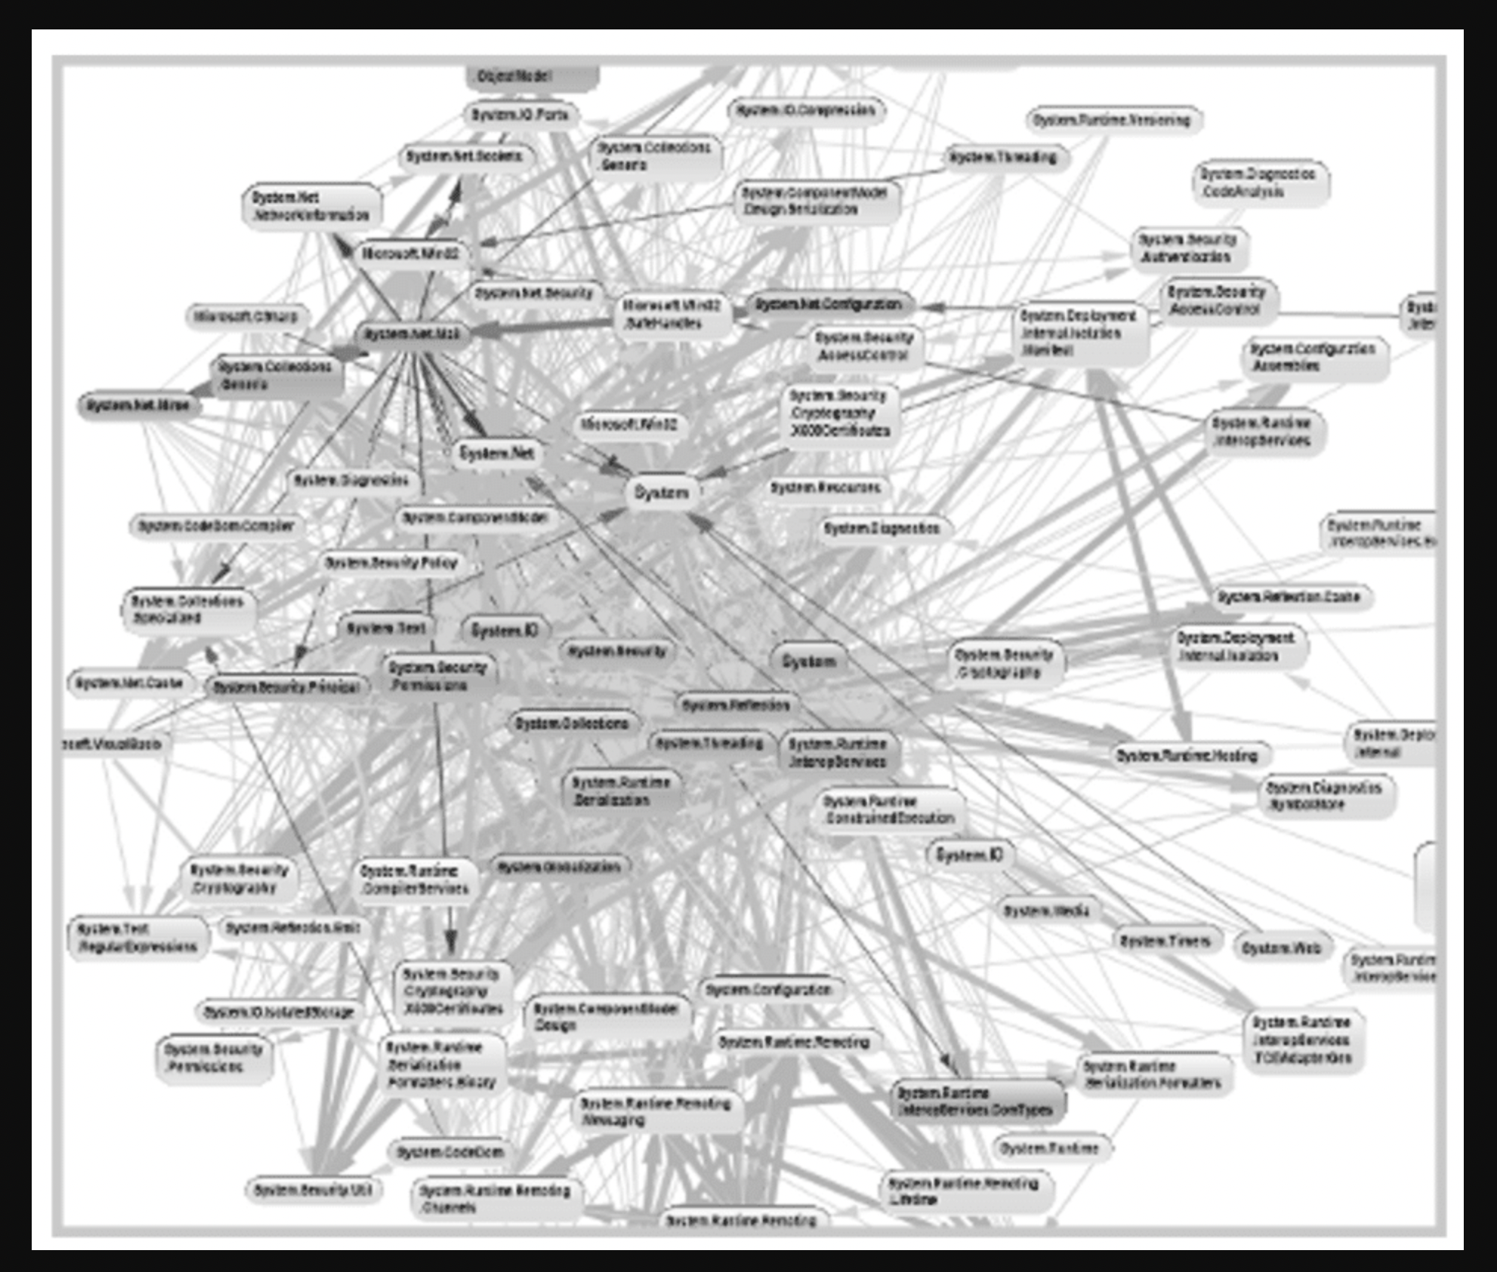
E.On Development Guild
dds
Monolith class dependency

Slide 12
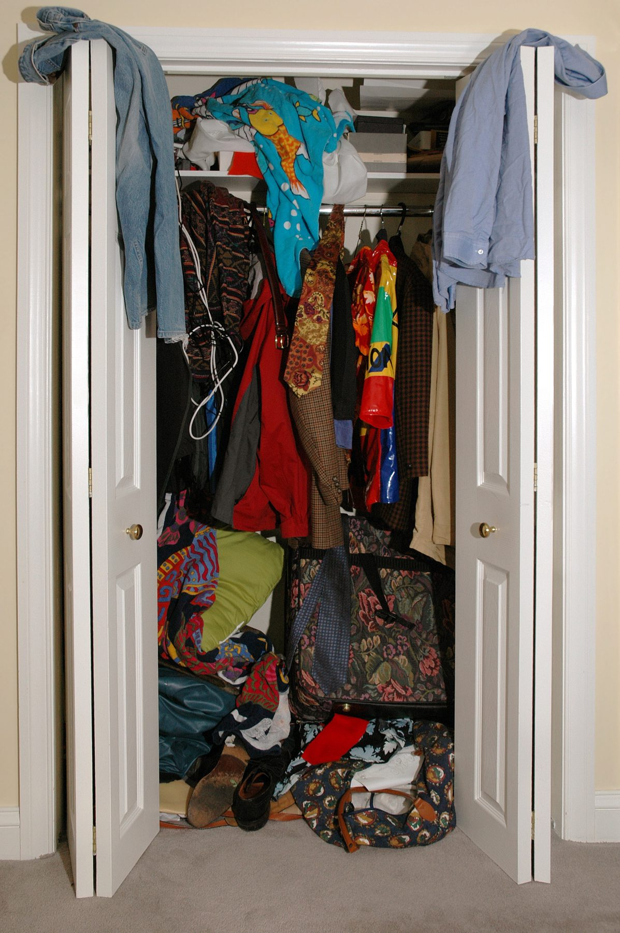
Bad monolith/Big ball of mud:

Slide 13
E.On Development Guild
Problem: Unified Single data model
Solution: Multiple data models and data multiplication

Slide 14
E.On Development Guild
Single data model vs multiple data models
Monolith
(Unified data
model)
Microservices
Modulith
(Multiple data
models)
Bounded context
Bounded context
Bounded context
Bounded context

Slide 15
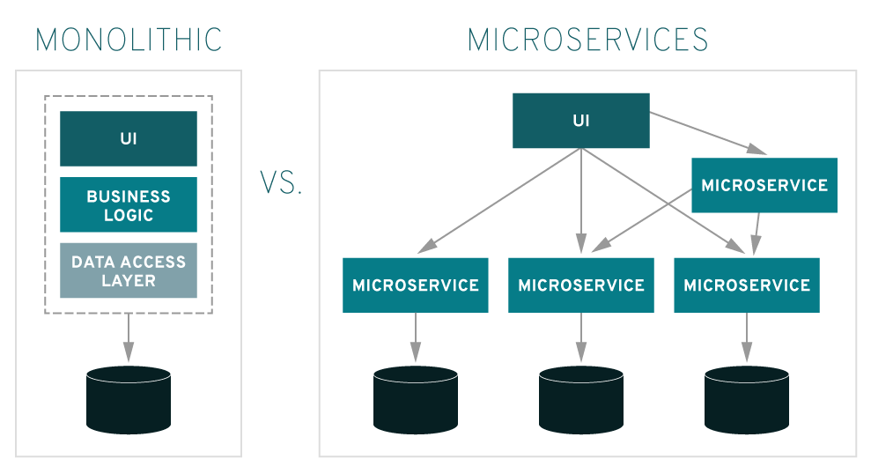
E.On Development Guild

Slide 16
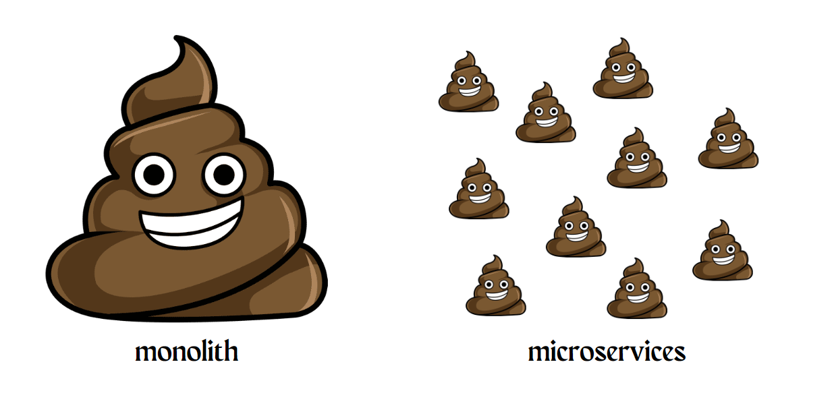
E.On Development Guild

Slide 17
E.On Development Guild
Microservices
Monolith
Modulith
When not to choose microservices?
MVP
Startup
Greenfield
Modular monolith= intermediate step to microservices
Google
Amazon
Netflix

Slide 18
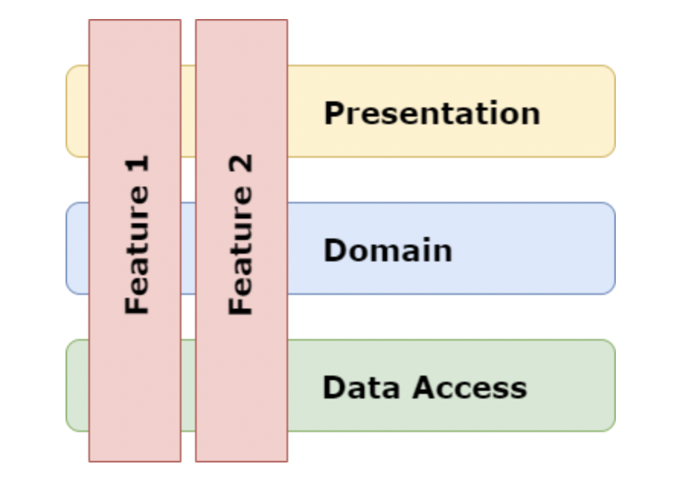
E.On Development Guild
How to migrate from a monolith to microservices?
Problem: Big ball of mud
Solution: Vertical slice Architecture= isolate different features. Can transform a monolith into a modular monolith. In future, those vertical slices can be extracted into a microservice
Vertical slice Architecture = High Cohesion over Business capability, not over technology layers

Slide 19
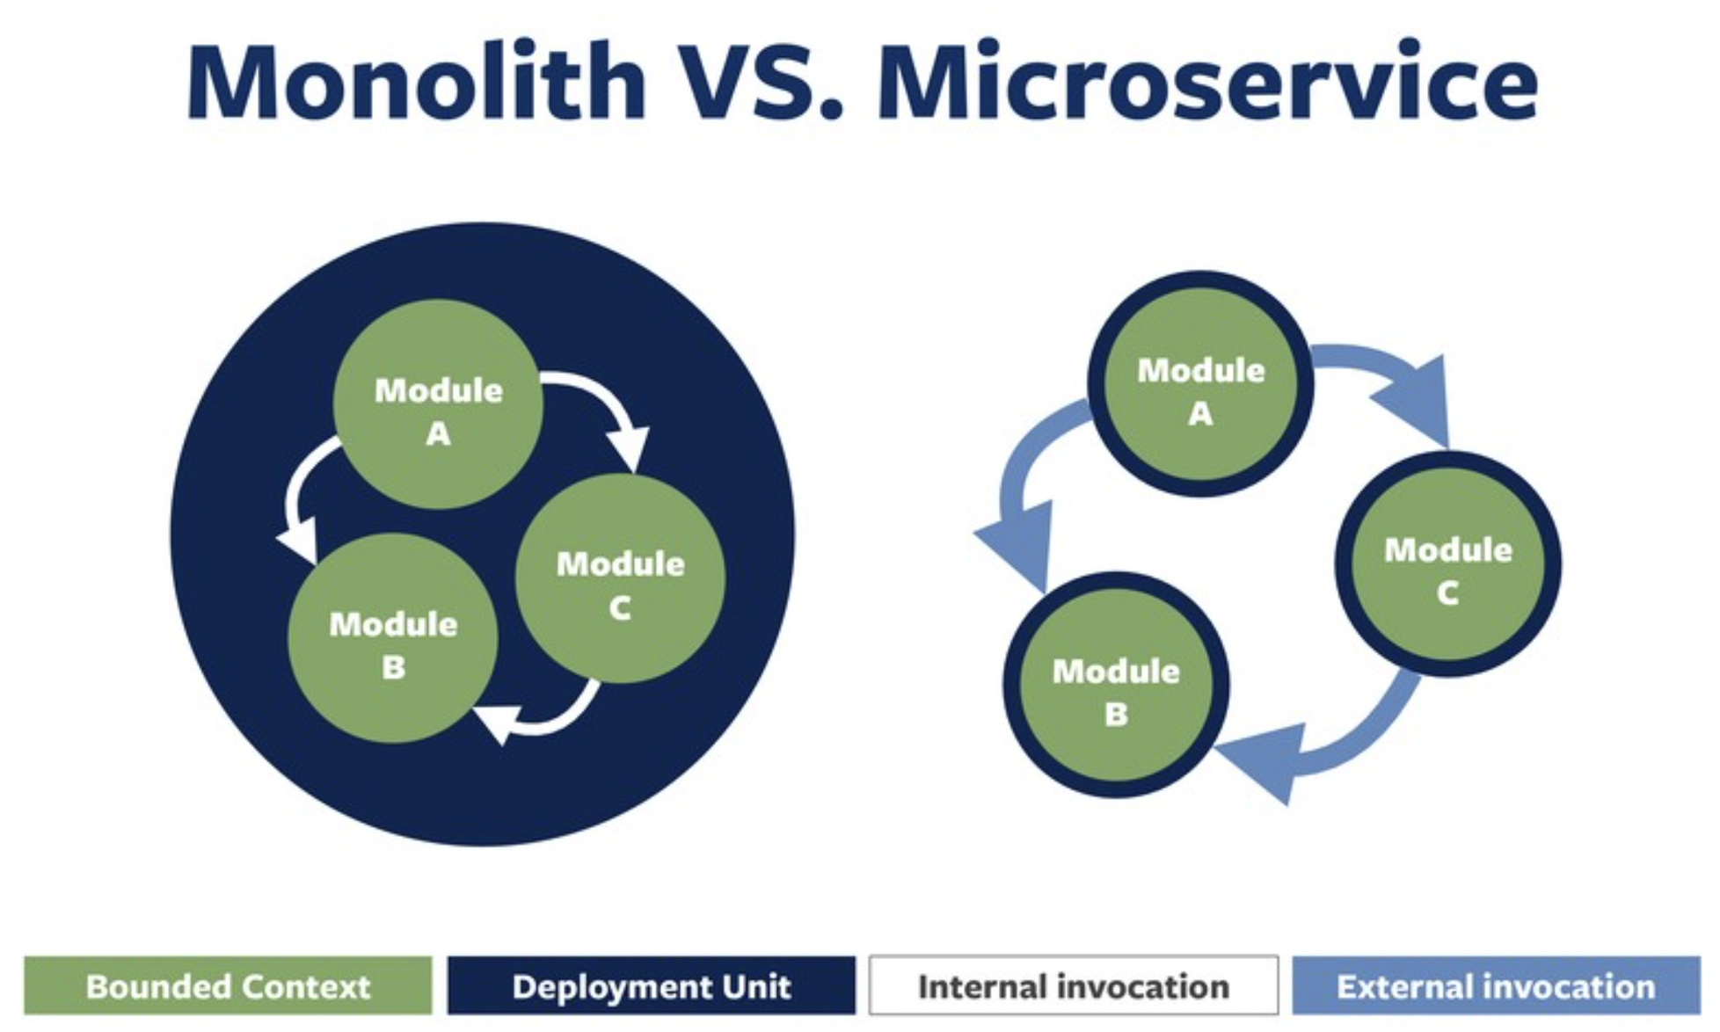
E.On Development Guild

Slide 20
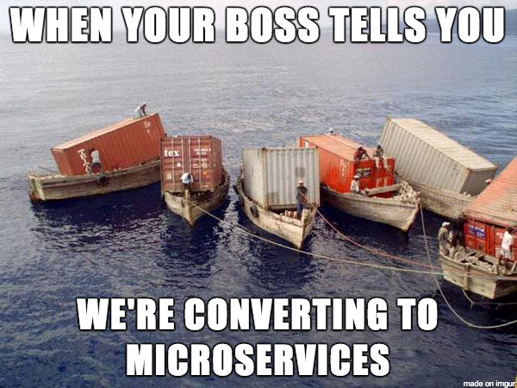
E.On Development Guild

Slide 21
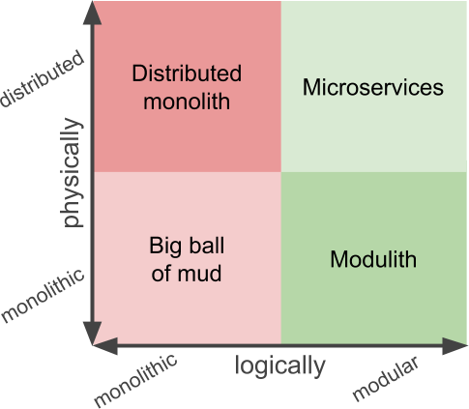
E.On Development Guild

Slide 22

E.On Development Guild

Slide 23
E.On Development Guild
Microservices
Advantages:
-are build around business capabilities
-Independent deployment- other microservices are not affected
-Programming language agnostic (uS1- Python, uS2- Java, uS3- Rust, etc )
- scalability
- high availability (retry mechanisms)
- fault tolerance
Data governance- each microservice has a database
Data ownership- a team can own a microservice
Expose data outside using API
Disadvantages
- Complexity : transactions(no ACID) & data synchronization (eventual consistency)
- Communication between microservices (REST, gRPC, websocket)

Slide 24
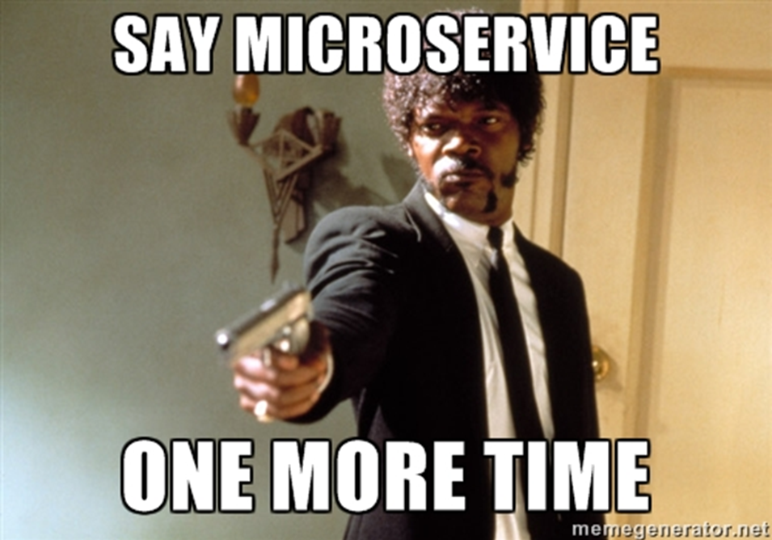
E.On Development Guild
Microservices
-More traffic, more data, more users = happy client 😀
-productive developer 😀
-happy manager 😀
-Sustain software agility in the face of growth

Slide 25
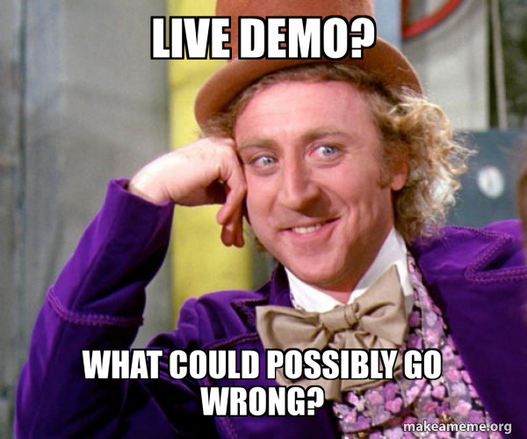

Slide 26
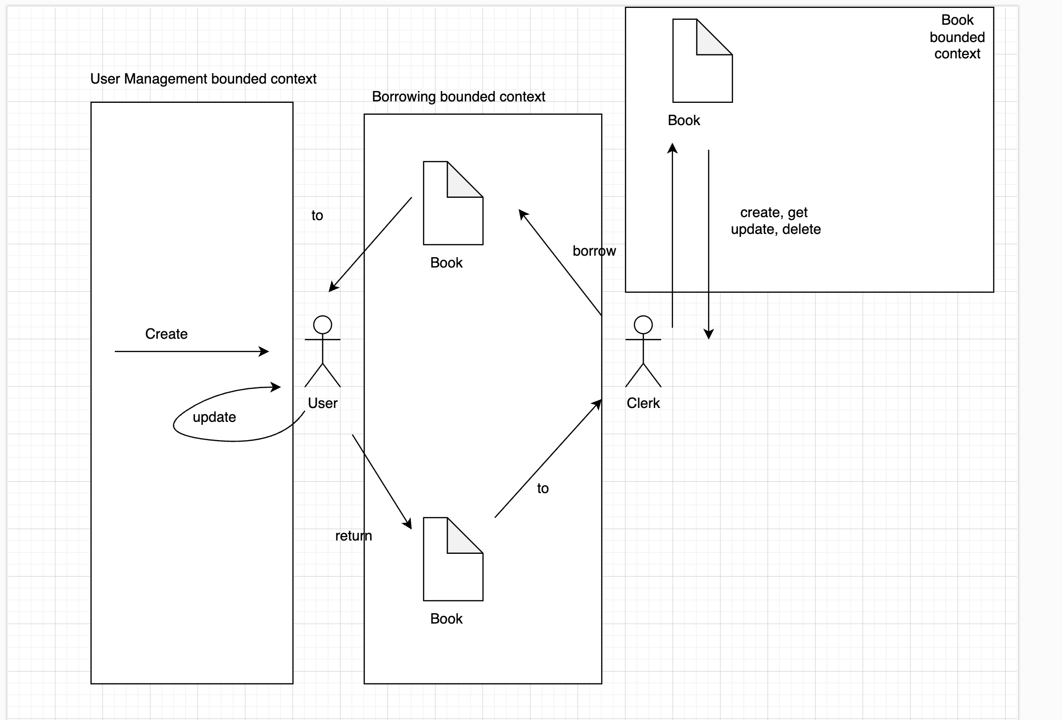
Demo: The Library app

Slide 27
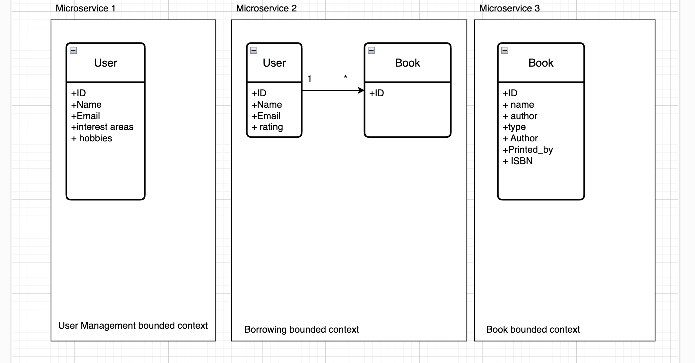
Demo: The Library app

Slide 28
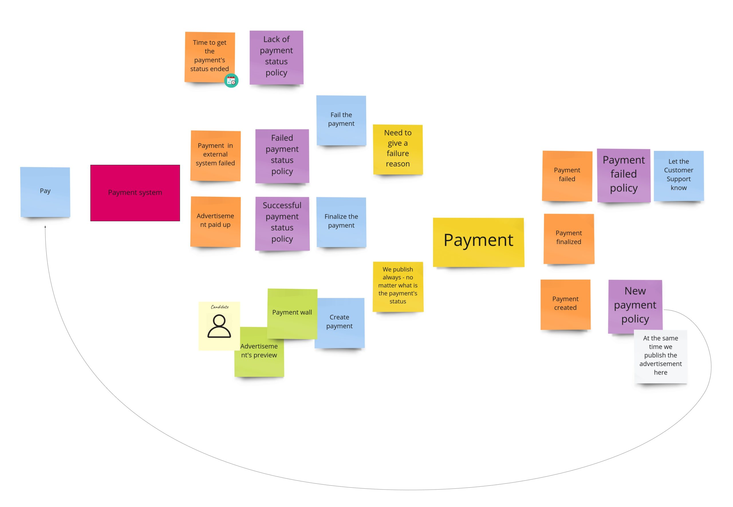
E.On
DDD Event storming

Slide 29
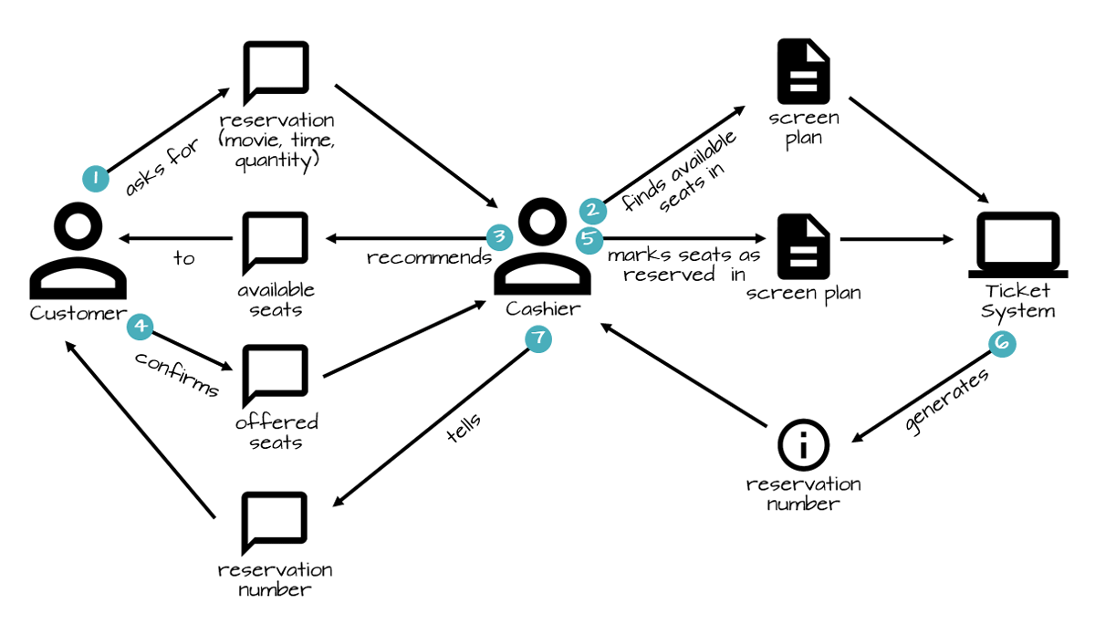
E.On Development Guild
DDD Storytelling

Slide 30

E.On Development Guild
Domain Driven Design By Eric Evans

Slide 31
E.On Development Guild

Slide 32
Questions?
Comments?
Feedback?

Slide 33
Thank you!

